Slide 1

Kingdom of Saudi Arabia
Ministry of Education
Prince Sattam Bin Abdulaziz University
College of Science and Humanities-Al-Aflaj
Department of Computer Science
المملكة العربية السعودية
وزارة التعليم
جامعة الأمير سطام بن عبد العزيز
كلية العلوم والدراسات الإنسانية – الأفلاج
قسم علوم حاسب
Predicting the risk of heart disease
Done By:
Khaled Abdullah AlOtaibi – 442850298 | Abdulelah Rashed Alojiry – 443850168
Yazeed abdullah alanazi – 443051051 | Sultan waslallah alMutairi – 442850137
Supervised By:
Dr. Abed Saif Ahmed Alghauly
Submitted in Partial Fulfillment for the Requirements of the Bachelor Degree in Computer Science
First Semester of 1446 H -2024G

Slide 2
01
04
Literature Review
Introduction
02
Project Objectives
05
Classification Algorithms in Machine Learning
03
Problem Statement
06
Performance Metrics
AGENDA

Slide 3
Abstract
Heart disease is a leading global cause of death, making early detection critical for better patient outcomes.
This project aims to create a machine learning model to predict heart disease risk using patient data, including demographics, medical history, and clinical metrics.
By leveraging these attributes, the model will identify high-risk individuals, facilitating early interventions and improving cardiovascular health.

Slide 4

Introduction
Heart disease is a significant global health issue, with increasing prevalence in Saudi Arabia due to lifestyle changes, poor diets, physical inactivity, and genetic factors.
Early identification of individuals at risk is essential to improve patient outcomes and reduce healthcare burdens.
Machine learning offers the ability to analyze complex datasets and predict heart disease risks using patient data such as age, cholesterol levels, and smoking habits.

Slide 5
Introduction
This project aims to develop a machine learning model for heart disease prediction using publicly available datasets, enhancing early diagnosis and healthcare decision-making.
The project emphasizes tailoring solutions to Saudi Arabia's specific needs by integrating local and global datasets.
Challenges include ensuring data quality, addressing ethical issues, and achieving model transparency for better acceptance and effectiveness.
The project seeks to create a reliable predictive tool and advance the application of data science in addressing critical health issues.

Slide 6
Project’s Objective
Data Collection and Preprocessing
Model Development and Evaluation
Implementation of a Predictive Model
Gather a dataset with features related to heart disease (e.g., demographics, clinical and lifestyle factors) and preprocess the data by cleaning and normalizing it for accurate analysis.
Build various machine learning models (e.g., decision trees, support vector machines, neural networks) to predict heart disease risk and assess their performance.
Train a machine learning model to assist healthcare professionals and individuals in detecting heart disease risk using input data.

Slide 7
Problem Statement
Heart disease is the leading cause of death worldwide, accounting for 17.9 million deaths annually (32% of all deaths). Many of these deaths stem from preventable risk factors.
Timely diagnosis is crucial for improving outcomes and reducing healthcare costs, yet traditional diagnostic methods are often inaccessible or expensive, especially in low-resource settings.
Big data and machine learning offer promising tools for analyzing large datasets to predict heart disease risk factors, but these methods face practical application challenges in real-world settings.
Existing models often lack applicability to diverse populations, which limits their effectiveness.

Slide 8
Literature Review
Study | Prediction Using Jellyfish Optimization Algorithm | Effective Heart Disease Prediction Using Machine Learning
Focus | Utilized machine learning with the Jellyfish optimization algorithm to address overfitting and select key features for heart disease prediction. | Aimed to enhance cardiovascular disease prediction using k-modes clustering and machine learning algorithms, including RF, DT, MP, and XGB.
Dataset | Cleveland heart disease dataset. | 70,000 instances from Kaggle.
Findings | SVM classifier combined with Jellyfish optimization achieved the best results (98.47% accuracy and 94.48% AUC), demonstrating effectiveness in dimensionality reduction and prediction accuracy. | Multilayer Perceptron with cross-validation outperformed others, achieving 87.28% accuracy and 0.95 AUC.

Slide 9
Literature Review
Study | Explainable AI for Heart Disease Prediction | Active Learning Machine Techniques
Focus | Developed a predictive system integrating feature selection (chi-square, ANOVA) with SHAP methods for interpretability and built a mobile application. | Employed neural networks and Learning Vector Quantization to develop robust models for heart disease prediction.
Dataset |  | UCI-repository
Findings | XGBoost using selected features achieved 97.57% accuracy and 98% AUC, showcasing high prediction effectiveness and practical application for early detection. | Learning Vector Quantization achieved the highest accuracy (98.7%), highlighting its potential for cardiovascular problem prediction. Naïve Bayes and Radial Basis Functions also performed well with 94.78% and 90.78% accuracy, respectively.

Slide 10
Classification Algorithms in Machine Learning
Notes:
ID=d924773e-9a16-4d6d-9803-8cb819e99682 Recipe=text_billboard Type=TextOnly Variant=0 FamilyID=AccentBoxWalbaum_Zero

Slide 11
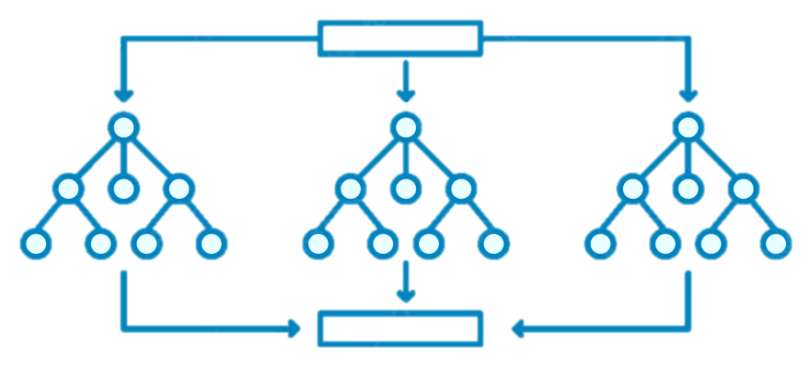
Random Forest
Description: An ensemble method combining outputs of multiple decision trees to enhance prediction accuracy.
Key Features:
Uses bagging and feature randomness for uncorrelated trees.
Parameters include node size, number of trees, and sampled features.
Applications: Finance, healthcare, e-commerce.
Benefits:
Flexibility
Reduced overfitting risk
Ease of determining feature importance.

Slide 12
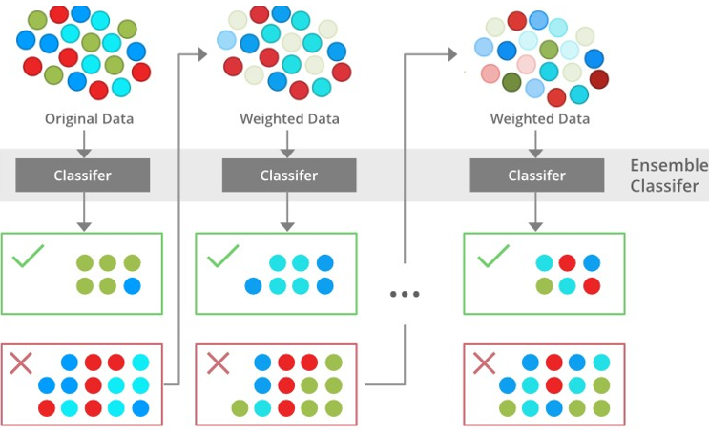
XGBoost
Description: An advanced gradient boosting technique that builds sequential models to minimize prediction errors using gradient descent.
How It Works:
Initialize predictions (e.g., mean values).
Train trees iteratively to reduce residuals.
Combine all trees for the final prediction.
Applications: Healthcare diagnostics, financial risk assessment, customer churn prediction.
Challenges: Overfitting, scalability issues for large datasets.

Slide 13
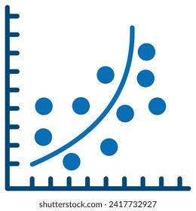
Logistic Regression
Description: A statistical method used for binary and multi-class classification by modeling probabilities.
Types:
Binomial (e.g., pass/fail).
Multinomial (e.g., dog/cat/sheep).
Ordinal (e.g., low/medium/high).
Applications:
Healthcare (disease prediction).
Finance (fraud detection, loan evaluations).
Marketing (ad response predictions).
Advantages: Simplicity, speed, and flexibility.

Slide 14
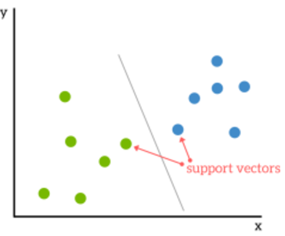
Support Vector Machine (SVM)
Description: A supervised algorithm that identifies a hyperplane to separate data into classes with the widest possible margin.
Features:
Support vectors determine the hyperplane.
Kernel methods handle non-linear separations.
Advantages: High accuracy, efficiency with smaller datasets.
Challenges: Computationally expensive for large datasets and less effective with noise.

Slide 15
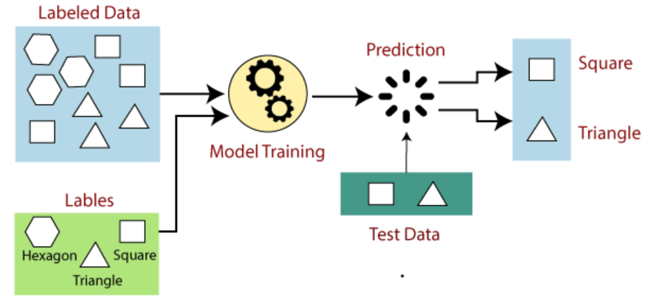
Machine Learning Process

Slide 16
Performance Metrics
Notes:
ID=d924773e-9a16-4d6d-9803-8cb819e99682 Recipe=text_billboard Type=TextOnly Variant=0 FamilyID=AccentBoxWalbaum_Zero

Slide 17
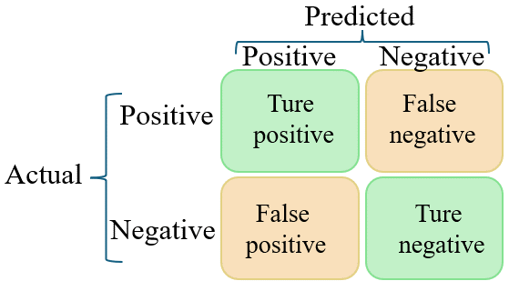
Confusion Matrix
A table summarizing prediction outcomes:
True Positive (TP): Correctly predicted positives.
True Negative (TN): Correctly predicted negatives.
False Positive (FP): Incorrectly predicted positives.
False Negative (FN): Incorrectly predicted negatives.

Slide 18
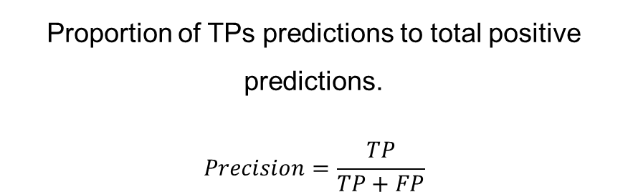
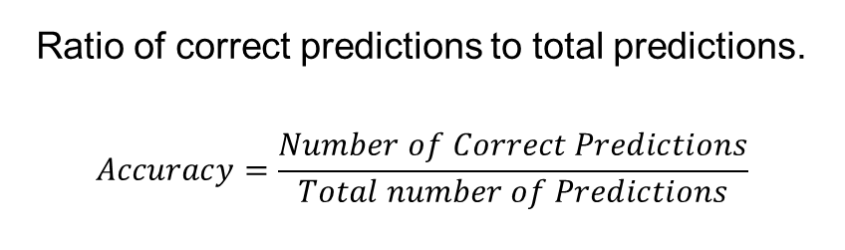
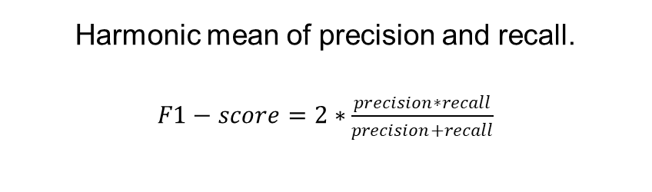
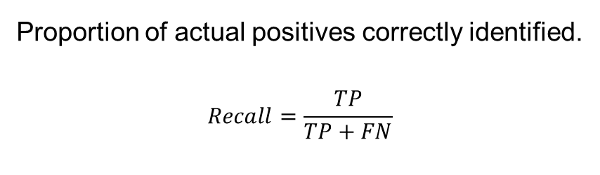
Performance Metrics
Accuracy
Precision
Ratio of correct predictions to total predictions.
$$Accuracy=\frac{Number of Correct Predictions}{Total number of Predictions}$$
Proportion of TPs predictions to total positive predictions.
$$Precision=\frac{TP}{TP+FP}$$
Recall
F1-Score
Proportion of actual positives correctly identified.
$$Recall=\frac{TP}{TP+FN}$$
Harmonic mean of precision and recall.
$F1−score=2∗\frac{precision∗recall}{precision+recall}$

Slide 19
THANK YOU!

